Slide 1
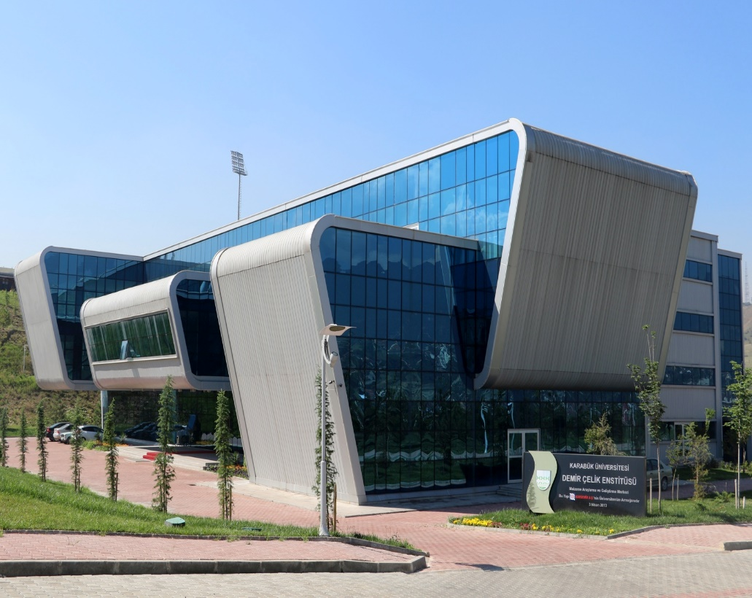
KARABUK UNIVERSITY IRON & STEEL
INSTITUTE

Slide 2
History
2011
Founded
2012
Admission of Karabuk University Iron & Steel Institute Council Guideline
2013
Many laboratories start testing within MARGEM (Materials Research & Development Center)
Today
I&SI keeps conducting Its activities by gaining more strength day by day with specified missions and visions towards the University – Industry Cooperation.
Notes:
Foundation of our institute goes back to 6 years ago, and after two years of public and private investments our Labs have been executed within (Material Research Centre (MARGEM). Today we keep conducting our activities not with inertia but dynamically by further improving the capabilities of our institute.

Slide 3
MISSION & VISION
Notes:
I will also shortly mention the mission and vision of our institute.

Slide 4
MISSION & VISION
Mission Vision
1
1
Create a platform to share difficulties in Iron & Steel Industry and other industries and seek for scientific solutions.
Contribute to Public politics related to basic issues in Iron & Steel Industry.
2
2
Support research on new technologies for sustainable development
Educate employees in Iron & Steel sector on new technologies and processes.
3
Provide information on Labor Health and Safety as well as sustainable environment.
3
Create public awareness on emission reduction by utilizing new technologies
4
Interpret on industrial data for decision makers and iron & Steel Sector. Suggest on production processes, energy efficiency, investments and global tendencies.
4
Support use of steel based products as the most recyclable material in the world, by increasing its market share.
Notes:
We are committed to contribute to public policies for development and value added products in specifically iron and steel sector. To educate qualified human resources as well as graduate degree personnel for this sector. Focusing on environmental and labor health concerns and especially interpret and comment on shortcomings on iron and steel sector with many experts in the field.
Here in our institute we keep supporting research from universities and private sector, and try to depict the importance of value added products and RD by utilizing new technologies.

Slide 5
QUALITY MANAGEMENT
As the executives of MARGEM Laboratories, we hereby commit to effectively conduct and continuously enhance the Quality Management System with the contribution of all our staff by following the standards of TS EN ISO/IEC 17025, TURKAK guides, costumer and legal conditions.
Notes:
With our quality management systems and many accredited laboratories we commit to enhance standards for the sake of legal conditions and our customers. Accredited testing is welcomed by the industry since they may be eligible to enter to international markets easily.

Slide 6
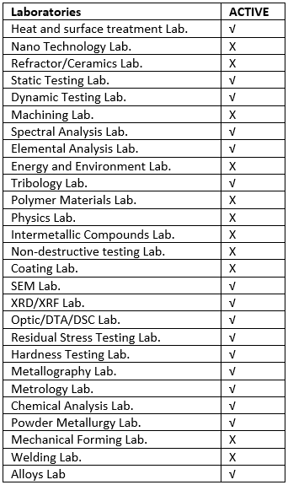
I&SI-INDUSTY COOPERATION
In MARGEM Laboratories; testing and quality control, consultancy services, education of qualified human resources, performing R&D within University – Industry cooperation, developing further cooperation with other R&D centers are aimed.
17 of 28 Laboratories are presently active.
Notes:
The testing devices in our institute is specifically selected in order to respond to problems of iron and steel industry, which is intensively present in our city. Presently 17 of 28 labs are fully active and serve for the community, while some others are semi active and under activity if requested by researchers.
Our laboratories are ranging from Mechanical property specifications to elemental and microstructure analysis.

Slide 7
OUR TEAM
Director
1 Secretary General
1 Faculty Member
8 Research Assistants
5 Administrative Staff
2 Vice Directors
Notes:
Our team is formed by 6 administrative staff, 8 researchers and 4 faculty totaling 18.

Slide 8
OUR TARGET
Educate qualified human resources for Iron & Steel sector with certification and graduate programs
Serve with accredited laboratories for testing and analysis activities that are supported by quality assurance systems for Iron & Steel sector
Improve and develop product quality in Iron and Steel sector
Become a center for excellence in R&D of value added products in Iron and Steel sector, and in metal alloys
Notes:
As connected to our mission and vision we also target especially for iron and steel sector to:

Slide 9
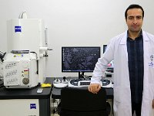
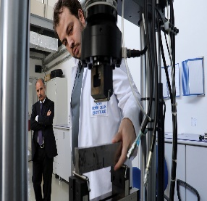
MARGEM LABORATORIES
Three-Step Sample Analysis Process
Fill the Analysis Request Form
Get an appointment from Sampling Admissions Unit
Testing of the sample on an appropriate date
Notes:
In our Material Research Center, three simple step will lead to sample testing.

Slide 10
MARGEM LABORATORIES
Steps in sample analysis
Analysis results report Results are submitted in a technical report format
Performing Analysis
Analyses are performed on the given date.
Apply to sample
admission unit .
Specifying the analysis date If the samples are suitable for analysis, testing fees are paid and a testing date is given.
Fill the relevant analysis request form
http://margem.karabuk.edu.tr/Website/formlistesi.aspx
Notes:
Further elaborating, after filling official forms and testing time is specified. Customers are informed on a date range of testing and test results are submitted in a report form following standards.
Since all our testing team are graduate students, even most of them are PhD students, they are eligible to comment on tested samples which is actually very helpful for customers and researchers to understand the reports of their tested samples. Reports can be prepared in both Turkish and English language by our technicians.

Slide 11
Metallography Laboratory
Metallography Laboratory
Sample preparation by using many methods as cutting, abrasion, lapping, bakeliting, and etching.
Image capturing in an optical microscope at a maximum of 2000X zooming.
Metallographic Processes ve Optical Microscopes Laboratory
Notes:
In our metallography lab, we bring the samples submitted by customers in a form that is testable. Also an image capturing can be made to check if the sample is ready for testing.

Slide 12
STATİC Test Laboratory
Static Test Laboratory (ACCREDITED)
Tensile Test (max. 600 kN, max 1100 °C)
Compression Test (max. 250 kN, 250 °C)
Bending Test (max. 250 kN, 250 °C )
ZWICK ROELL
Fatigue Test (max. 100 kN,)
Fracture Toughness Test (max. 100 kN)
Notch Impact Test (max. 450 J, -80 °C-100 °C)
Notes:
Our testing devices in the static lab are accredited and it is the most busy lab, serving for large iron and steel companies. Mechanical properties and characteristics of samples are detected in this lab. Here we have latest tech devices for major mechanical property testing, namely tensile, compression, bending, fatigue, fracture toughness, and notch impact tests. Also in our micro/macro hardness lab. All devices are accredited. We are able to investigate all types of materials hardness.

Slide 13
DYNAMİC Test Laboratory
Dynamic Test Laboratory (ACCREDITED)
Tensile Test (max. 600 kN, max 1400 °C)
Compression Test (max. 100 kN)
Bending Test (max. 100 kN )
MTS (100kN Servohydraulic Dynamic Testing Device)
Fatigue Test (max. 100 kN,) (ACCREDITED)
Fracture Toughness Test (max. 100 kN)
Notes:
Our accredited dynamic testing lab is also eligible to conduct mechanical property specification as in the Statics lab, and these tests are now made under motion conditions (we may call it variable load testing).

Slide 14
Residual Stress Measurement Laboratory
Real and safe unit strain distribution
Residual stress calculations based on strain distributions
Rail residual stress measurement within EN 13674-1 standards.
Vishay Residual Stress Measurement Device
Notes:
Variable shaped iron and steel products in general present a large amount of residual stress when cooled. Therefore we have our testing device for this to measure the residual stresses based on the strain in the sample.

Slide 15
SEM Laboratory
SEM Laboratory
Receive SEM images by increasing the sample temperature up to 750ºC by Hot-Stage
Point, linear and map type chemical composite analysis using EDX dedector.
ZEISS ULTRA PLUS FESEM
SE2, Inlens, STEM, EsB detectors.
Coating of dielectric surfaces with Au, Au/Pt ve C usinf coating device.
Notes:
Starting from SEM lab. We ar able to capture images at temperatures up to 750 degrees celscius, and we are able to make an elemental analysis of samples point based, linear aor mapping based, by request from the sample holder. Also we coat dielectric materials with a coating device for SEM testing.

Slide 16
XRD-XRF Laboratory
X-RAY DIFFRACTION (XRD)
-Cristal structure and phase specification of powder, bulk, thin film and metal samples.
-Non-destructive residual stress measurement
-Cristal tendency degree analysis
-High temperature analysis (25-1500 °C)
-Thin film analysis (GI­XRD and XRR)
-Micro area point analysis (down to 400μ area)
XRD-XRF
X-RAY FLUORESCENCE (XRF)
Qualitative and semi quantitative analyses of all types of samples (liquid, mineral, rock, polymer, oil, petrol, soil, glass etc.) from Boron to Uranium.
Full quantitative analysis can be made for stainless and low alloy steel.
Notes:
Last tech XRD and XRF testing devices are used for elemental and spectral analysis of samples. Based on the sample, suitable testing is selected and and a precise elemental analysis is made by these devices.

Slide 17
FTIR-UV-Atomic Absorbtion Laboratory
FTIR (Fourier Transform Infrared Spectroscopy)
FT-IR analysis specifies the type and property of metals.
UV-VIS (Ultraviolet Visible) Spectroscopy
UV-VIS generally used for measurement of molecules in solutions or inorganic ions and their complexes..
BRUKER-THERMO
Atomic Absorption
Utilizes flame method for chemical elemental analysis.
Notes:
Metal types properties, measurement of molecules in solutions and inorganic ions are accomplished in our Fourier transform infrared spectroscopy device. This device is also used for molecular analysis for a larger range of elements.

Slide 18
Spectral Analysis Laboratory
Elemental analysis of following alloys and many more;.
Cast iron
Low alloy steel
Stainless steel
Tool Steel etc.
ATLANTIS
Notes:
In spectral analysis lab. We mainly focus on iron and steel products. The testing device is arranged specifically to iron, steel and its alloys.

Slide 19
DTA/TGA/DSC Laboratory
Differential Thermal Analysis (DTA)
Thermogravimetric Analysis (TGA)
Differential Scanning Calorimetry (DSC)
Mass loss,
Dehydration,
Quasi glass transition temperature analysis,
In metals, alloys, ceramics, glass, polymers etc.
HITACHI
Melting Point designation
Evaporation method
Phase change
Oxidation/Reduction
Notes:
DTA/TGA/DSC testing devices are generally used for mass loss by dehydration of samples, as well as designations on phase changes , oxidation/reduction and further physical properties of samples.

Slide 20
OTHER ACTIVE LABORATORIES
1
Heat Treatment Laboratories
2
Powder Metallurgy Laboratories
3
Tribolology Laboratory
4
Corosion and abrasion Laboratories

Slide 21
THANK YOU
Phone
444 0 478 - 7
Adress
Website
KARABÜK ÜNİVERSİTESİ
DEMİR ÇELİK ENSTİTÜSÜ
78050 KARABÜK
http://dce.karabuk.edu.tr
Symposium
International Iron and Steel Symposium
Notes:
In this presentation I briefly summarized our institute activities and Thank you for listening.

